Slide 1



Slide 2
Pasindu Rashmika
Our DevelopmentTeam
Team Leader-Full Stack Developer/Mobile App Developer
Pasindu Deshan
Backend Developer
Akila Hasintha
Mobile App Developer
Buddika Dananjaya
Mobile App Developer
Navodya Sesini
Frontend Developer
Minoli Bhagya
Frontend Developer

Slide 3

1 | Project Background
2 | Project Definition
3 | Project Solution
4 | Technologies
5 | Functionalities
6 | Diagrams
7 | Design
8 | Current Progress
OUR CONTENT

Slide 4
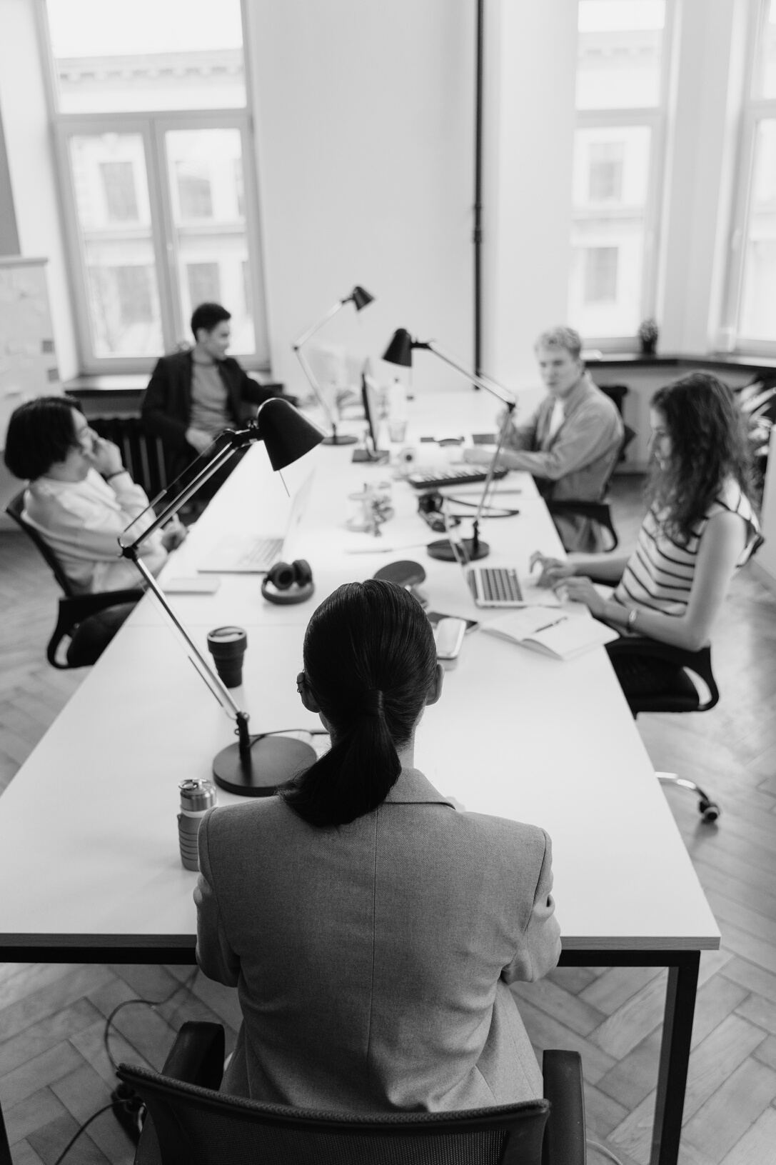
Problem Background
University Medical Center
Most important and useful place
Amount of students
Many Processes

Slide 5
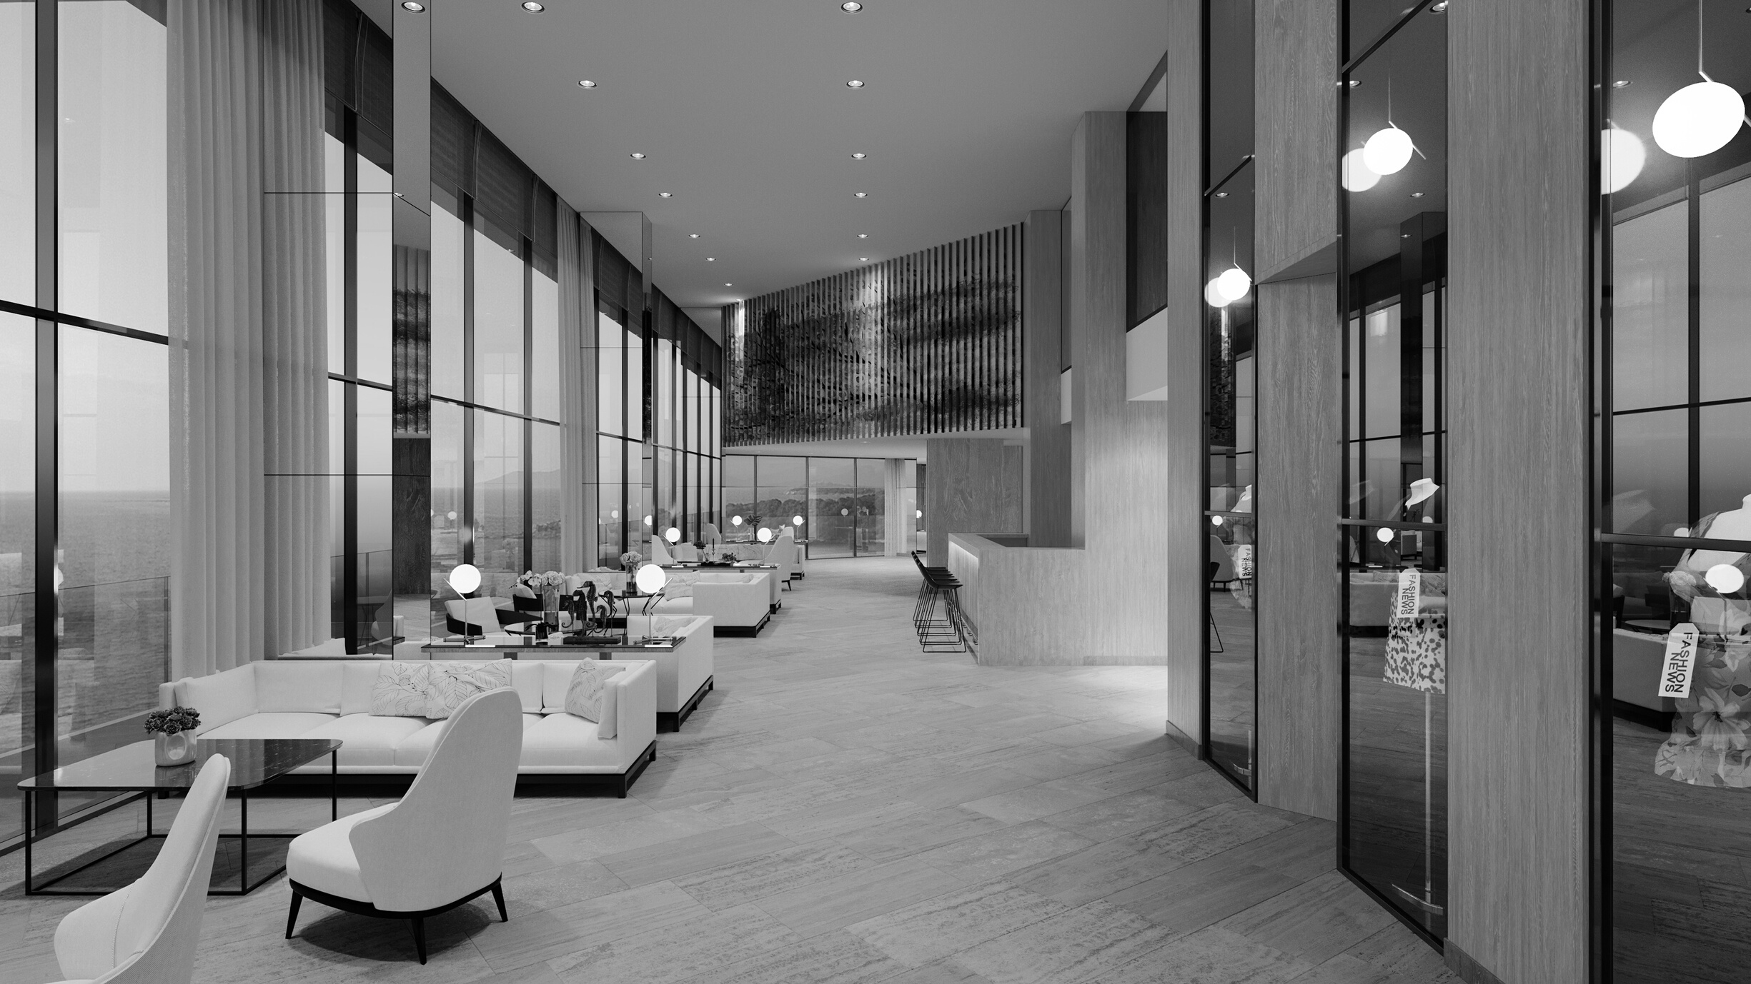
Problem Definition
Manual System
Manual System
Search Books
Doctor Availability
No Evidence

Slide 6


PROPOSED SOLUTIONS
Main Solution
Developing a system to maintain the process
Solution # 1
Web Application
Solution # 2
Mobile Application

Slide 7






Functionalities
Decision Making by Ai
All are computerized
SMS Alerts
Automated Email
Appointments
CRUD Operation
Push Notifications

Slide 8









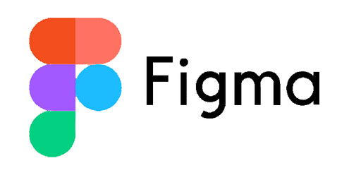
Technologies

Slide 9
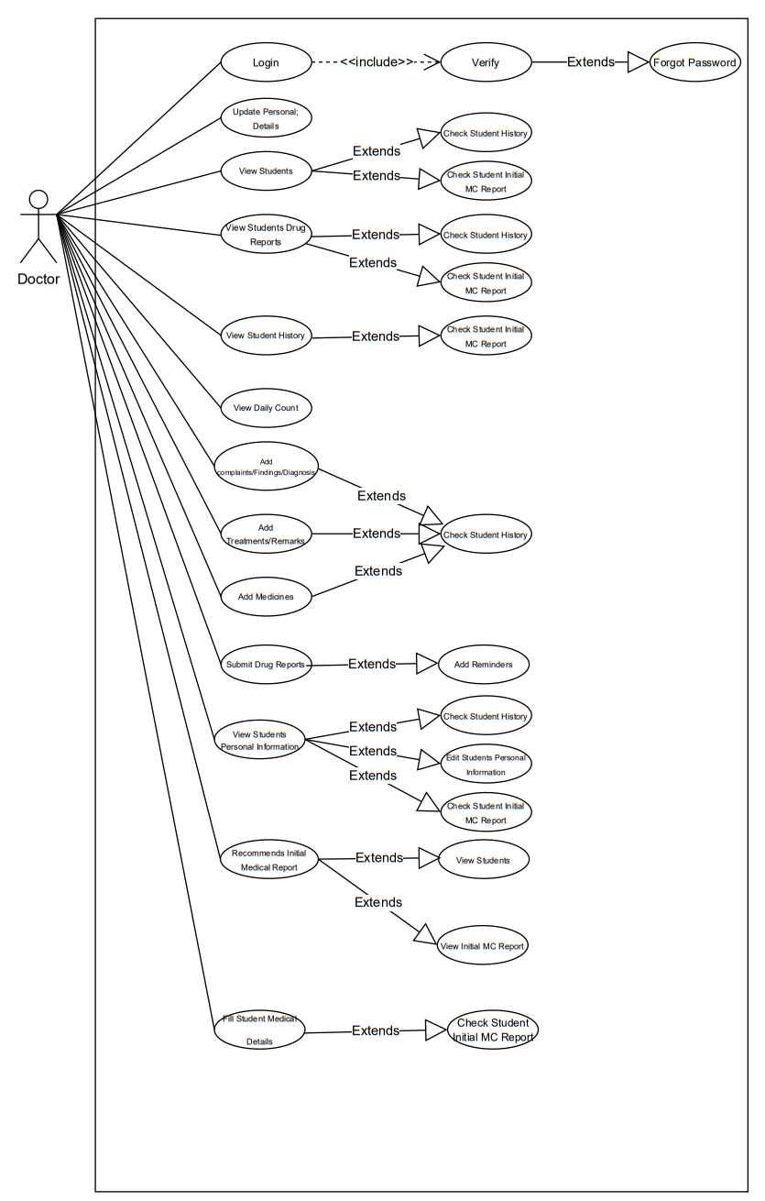
Doctor
Use Case

Slide 10
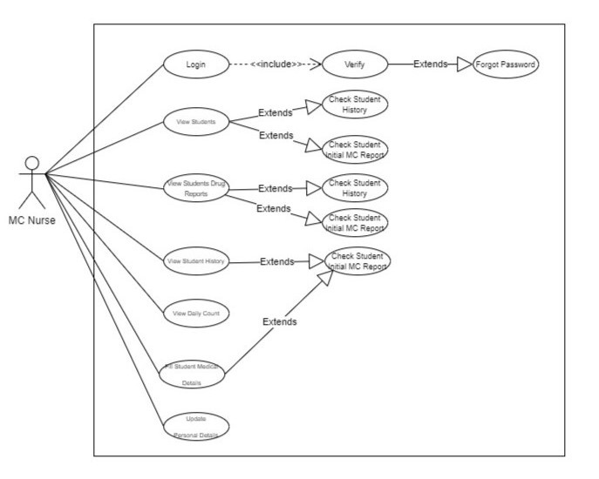
Nurse
Use Case

Slide 11
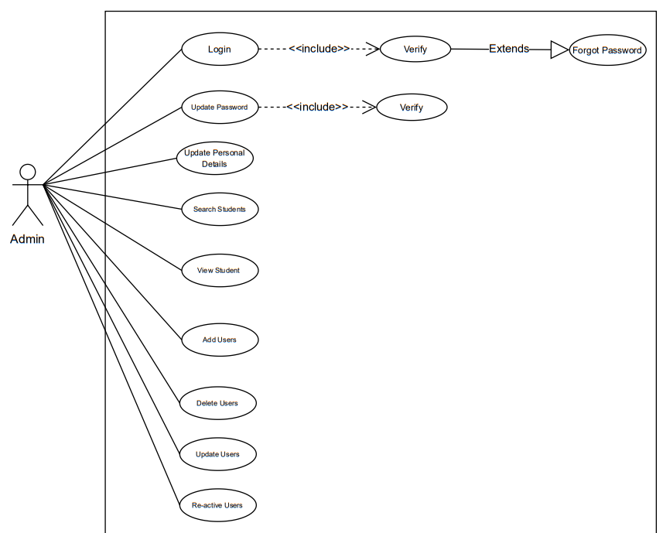
Admin
Use Case

Slide 12
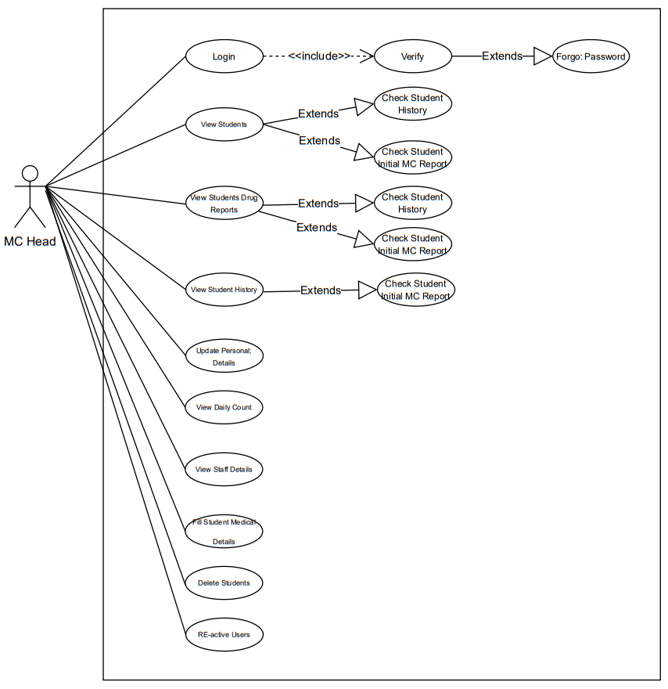
Medical Center Head
Use Case

Slide 13
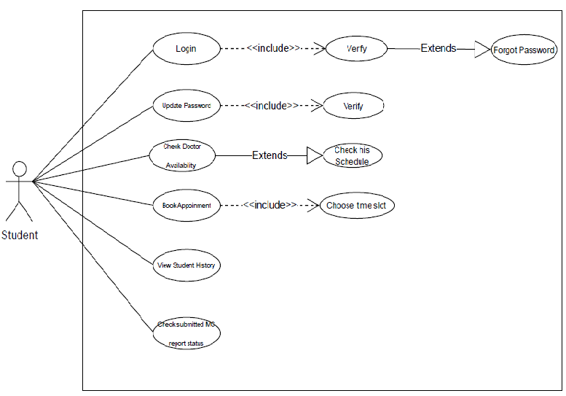
Student
Use Case

Slide 14
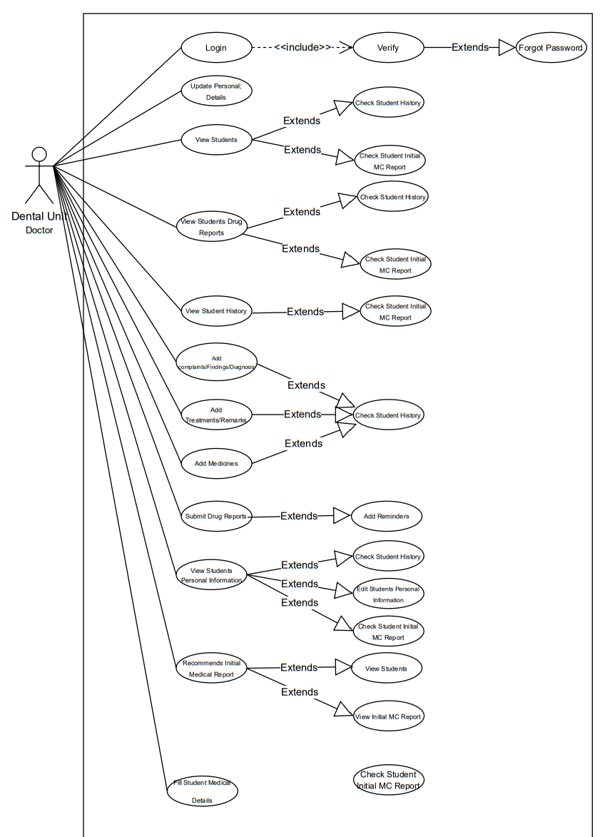
Dental Unit Doctor
Use Case

Slide 15
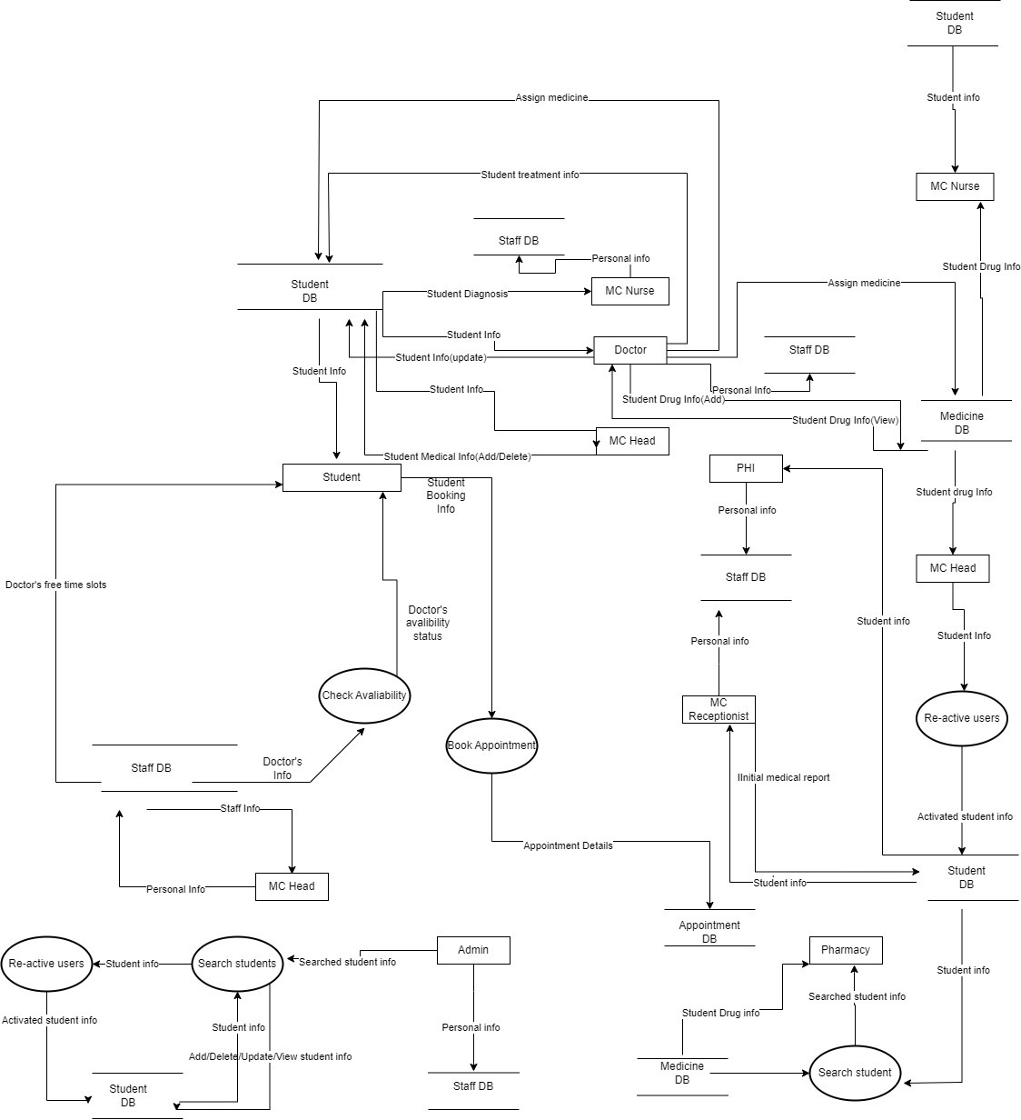
Data
Flow
Diagram

Slide 16
Activity Diagram

Slide 17
Design

Slide 18
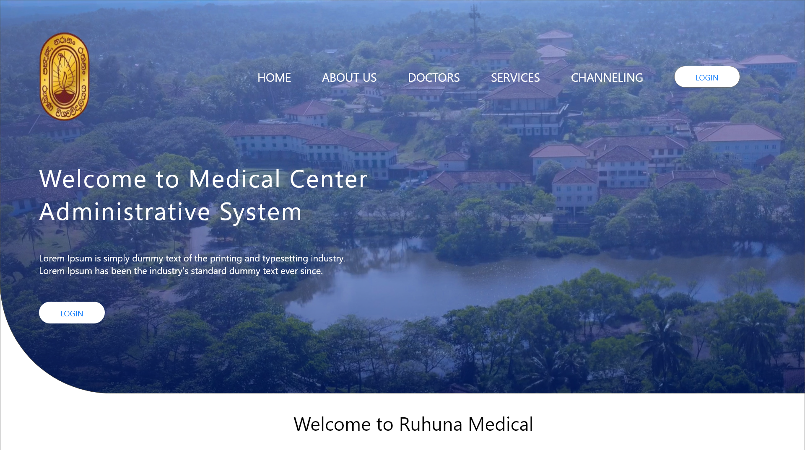
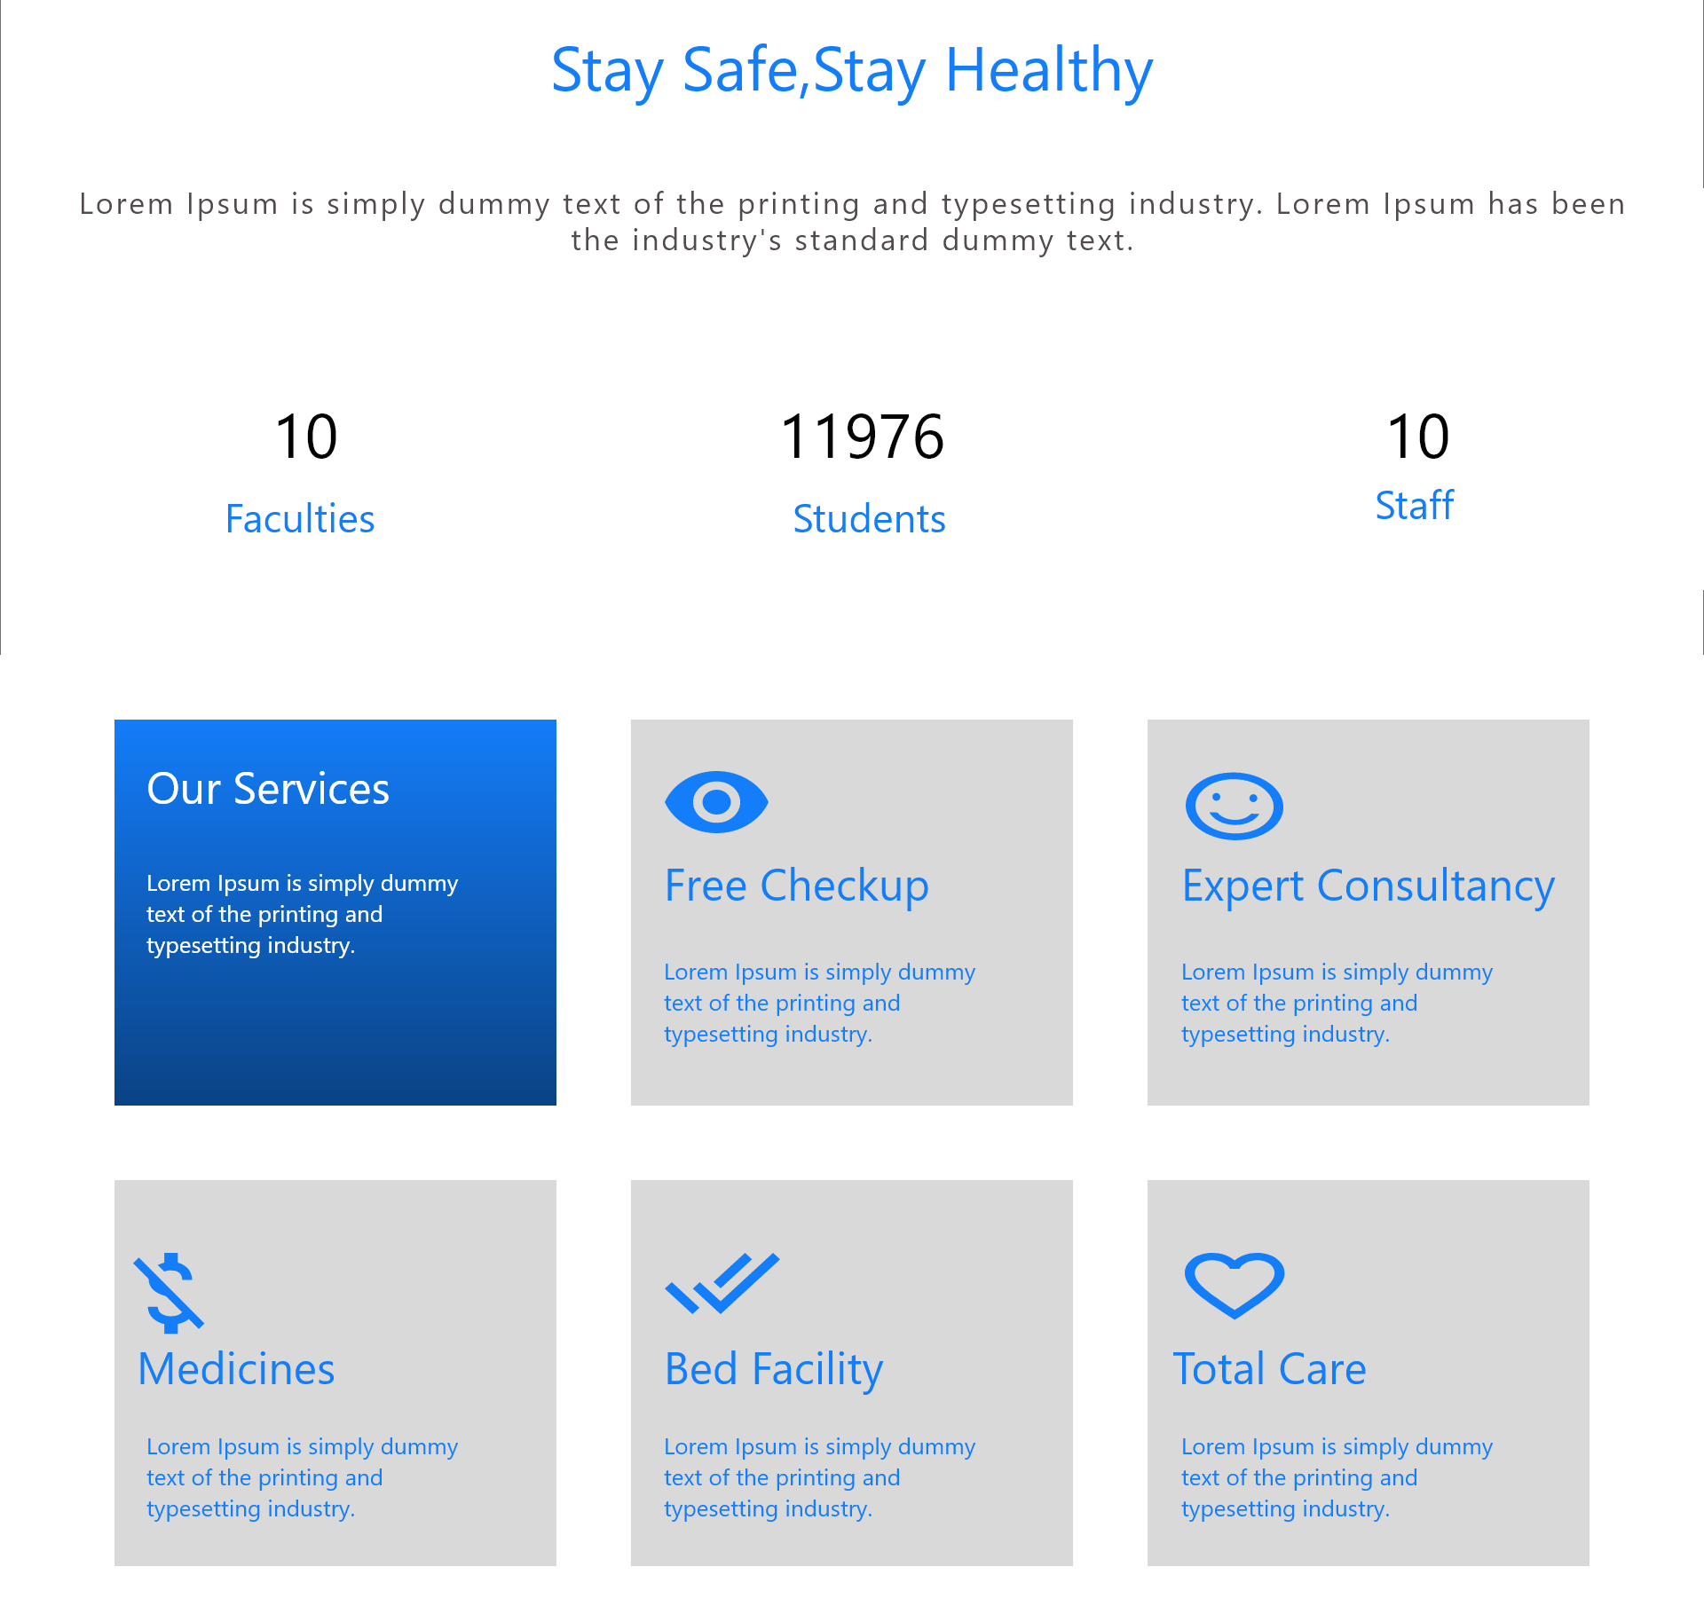
Web Application

Slide 19

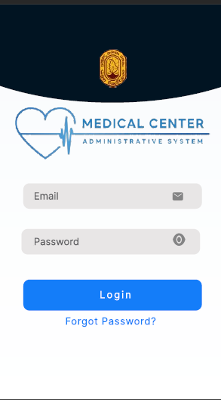
Mobile App

Slide 20
Current Progress
Requirement Gathering
90%
Frontend
20%
Backend
40%
Mobile App
35%

Slide 21
Thank You…!

